Slide 1
SMART RANCH MANAGEMENT SYSTEM
For Kenyan Smallholder Farmers in Ranch or animal keeping business.
PROBLEM: 78% of Kenya's agriculture depends on smallholders struggling with:
• Manual record-keeping → poor tracking (health , weight , feeding, finances, production[milk ,meat, manure],breeding ,expenses (PnL)
• No health monitoring → delayed interventions
• No financial oversight → low profitability
Consequences:
  Inaccurate expense tracking
  Poor health monitoring
  No data-driven decisions making
SOLUTION: Mobile app using Flutter & FastAPI
Eugine Onyango Odhiambo | EBI/61390/22
COSC 482 | Supervisor: Bernard Ongera Osero

Slide 2
OBJECTIVES & CORE FEATURES
GENERAL OBJECTIVE:
Design scalable mobile system to enhance efficiency, accuracy & profitability
SPECIFIC OBJECTIVES:
1. Analyze Kenyan-specific requirements
2. Build async FastAPI backend + PostgreSQL HTAP
3. Develop Flutter cross-platform app
4. Create future-ready architecture
5. Rigorous testing & evaluation
CORE FEATURES:
• Inventory (Individual + Batch tracking)
• Health monitoring with audit trails
• Feed consumption & FCR calculation
• Financial expense tracking

Slide 3
SYSTEM REQUIREMENTS SUMMARY
FUNCTIONAL:
1. Inventory Management (individuals + batches)
2. Expense Tracking (categorized & linked)
3. Feed Consumption (FCR calculation)
4. Health Monitoring (complete audit trail)
5. Reporting (financial + herd analytics)
NON-FUNCTIONAL:
• Usability: Simple for farmers with moderate digital literacy
• Performance: FastAPI async for low latency
• Security: Authentication + data encryption
• Scalability: Ready for IoT/ML integration

Slide 4
TECHNICAL INNOVATION
3-TIER ARCHITECTURE:
1. PRESENTATION: Flutter Mobile App
• Cross-platform (Android/iOS)
• Simple, intuitive interface
2. APPLICATION: FastAPI Backend
• Async-first for high performance
• Business logic & authentication
3. DATA: PostgreSQL with HTAP
• Hybrid Transactional/Analytical Processing
• Individual tracking + batch analytics simultaneously
KEY INNOVATION: Database handles real-time & analytical queries together

Slide 5
DEVELOPMENT APPROACH
METHODOLOGY: Agile-Scrum (2-week sprints)
6-MONTH TIMELINE:
MONTH 1-2: Foundation
• Requirements & database design
• Core API development
MONTH 3-4: Core Features
• Flutter app development
• Inventory & finance modules
MONTH 5: Testing & Polish
• User acceptance testing
• Performance optimization
MONTH 6: Delivery
• Final documentation & deployment

Slide 6
SCALABLE & FUTURE-READY
PHASE I (Current):
• Complete livestock management system
• Scalable 3-tier architecture
READY FOR PHASE II:
• IoT INTEGRATION: Animal sensors, GPS tracking
• MACHINE LEARNING: Disease prediction, feed optimization
• ADVANCED ANALYTICS: Geo-spatial, predictive models
DESIGN PRINCIPLE: Build foundation today, integrate AI/IoT tomorrow

Slide 7
WHY THIS PROJECT MATTERS
FOR FARMERS:
• Data-driven decisions → higher profits
• Better animal health → improved welfare
• Production and expense traction
FOR ACADEMIA:
• Practical software engineering demonstration
• Contribution to Kenya's agricultural digitization
FOR AGRI-TECH:
• African-context reference model(Aligns with Agriculture 5.0 )
• Addresses scalability gaps in existing solutions
CAREER VALUE: Mastery of Flutter, FastAPI, PostgreSQL - highly marketable skills

Slide 8
Expected Deliverables
Software:
  Working mobile app (Flutter)
  High-performance API (FastAPI)
  Optimized database (PostgreSQL HTAP)
Academic:
  Full documentation
  Source code with comments
  Final report & presentation

Slide 9
CONCLUSION
SUMMARY:
• Mobile solution for real Kenyan farming challenges
• Hybrid database for granular + aggregated tracking
• Future-ready architecture for IoT/AI integration
KEY ACHIEVEMENTS:
1. Solves critical record-keeping problem
2. Modern, high-performance tech stack
3. Designed for African smallholder context
4. Pathway to precision livestock farming
THANK YOU
Questions & Discussion & Answers

Slide 10
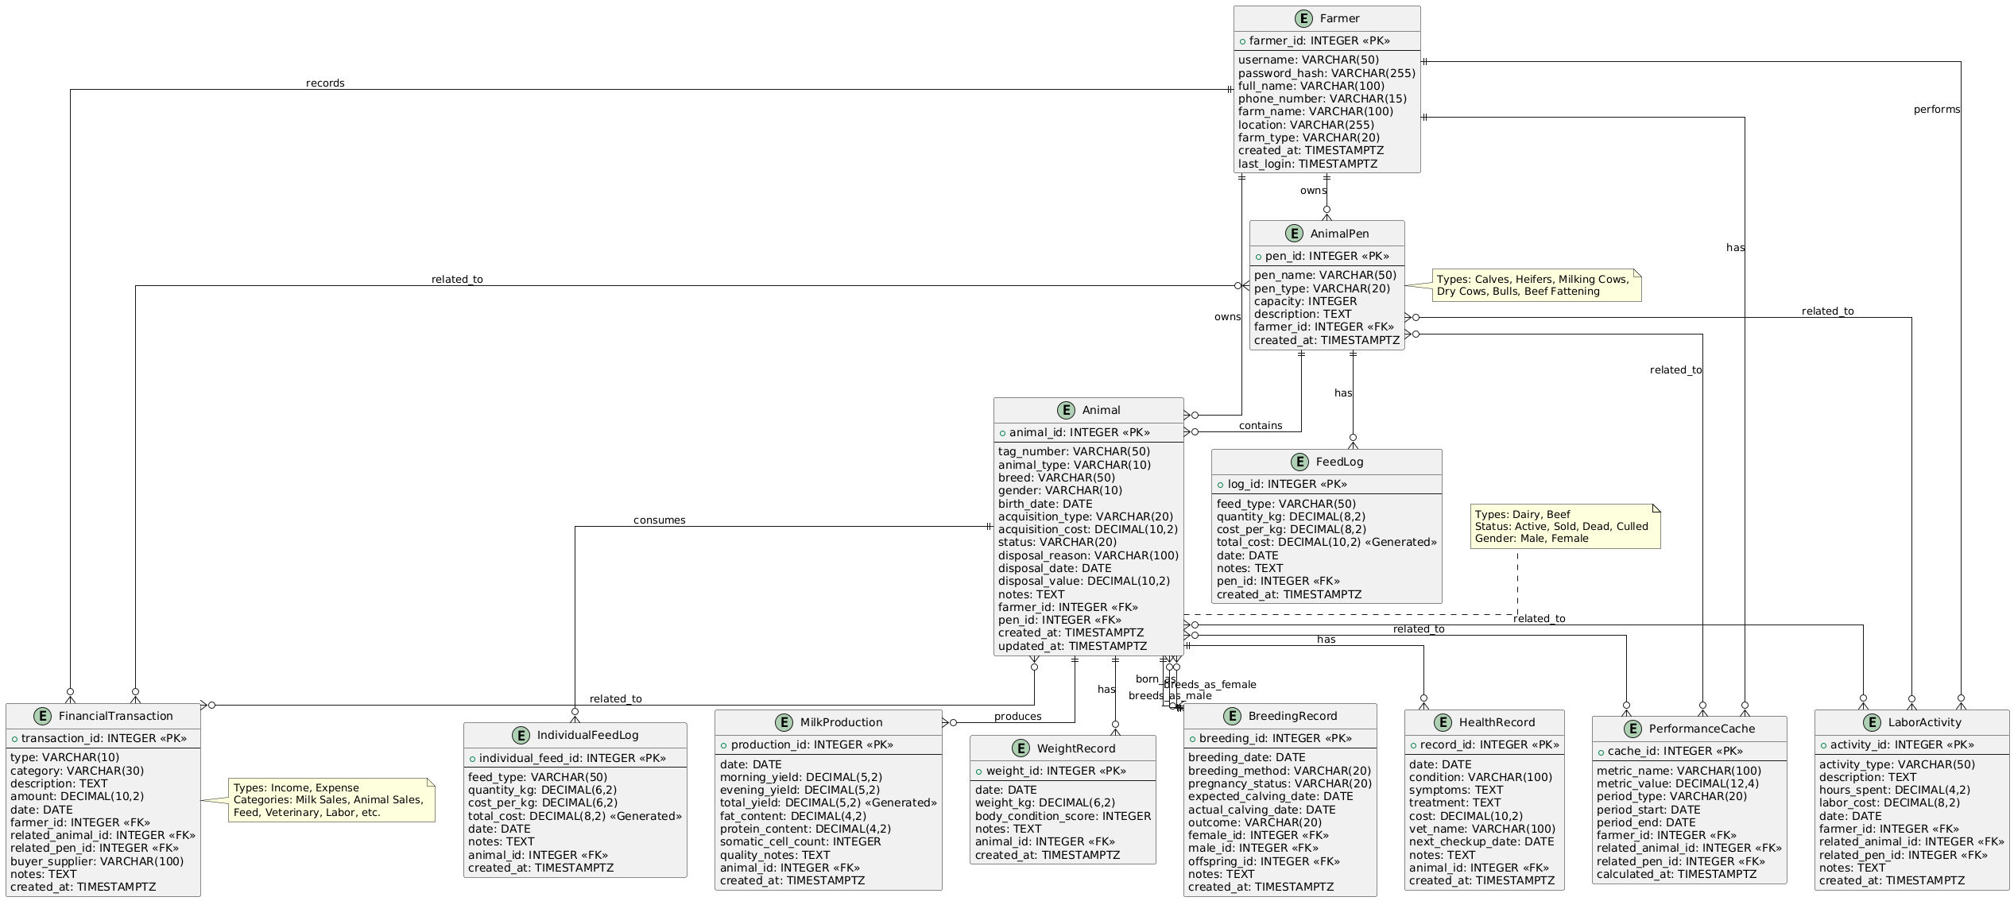

Slide 11
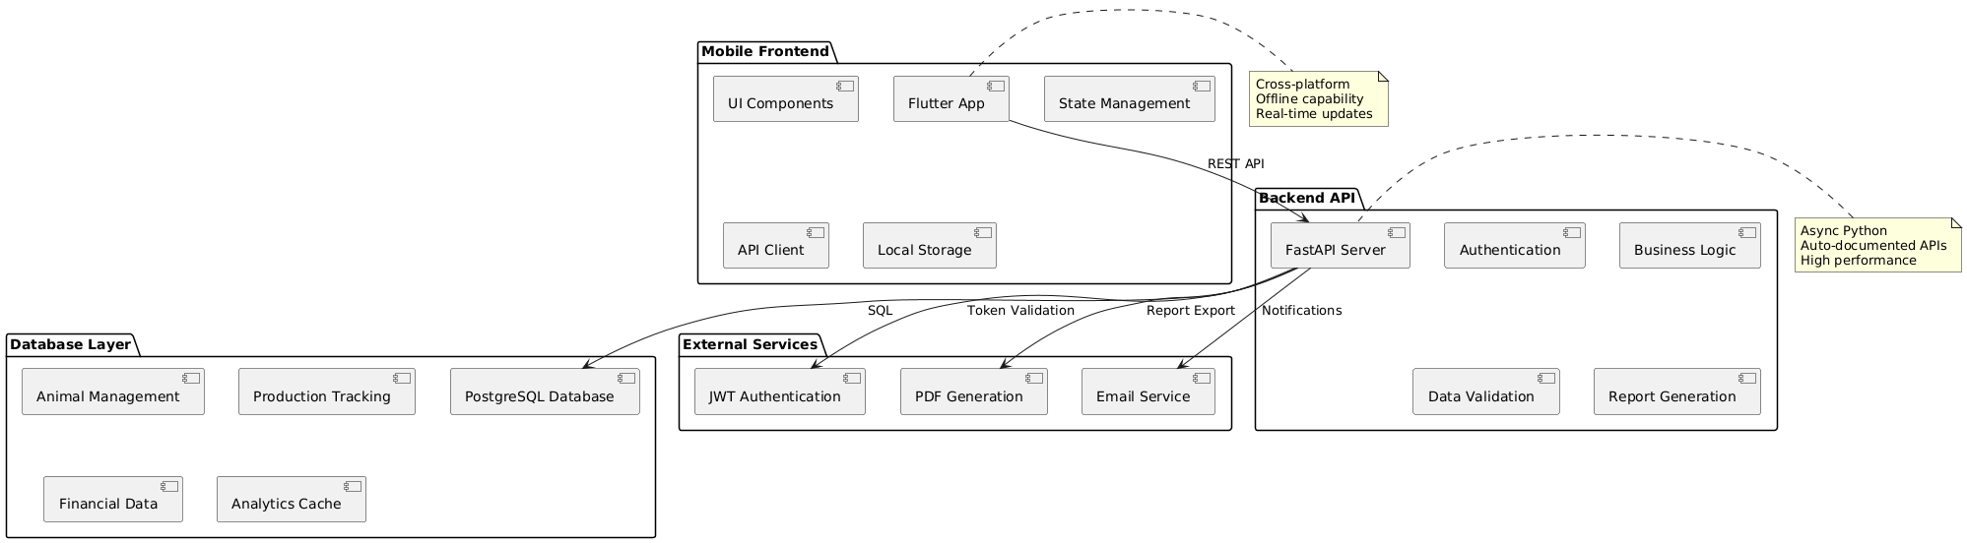

Slide 12
